Slide 1
Mobile APP Development
Researching APP’s – Lesson 1
Lesson 1

Slide 2
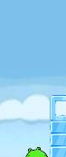
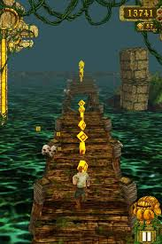
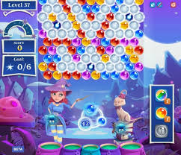
STARTER: Can you name these 3 Game APP’s?

Slide 3
Were you right?
Angry Birds
Temple Run
Bubble Witch

Slide 4
WALT and WILF
WALT – Understand what a mobile APP is and the categories they can belong to
WILF – A completed research task that shows the purpose of different APP’s

Slide 5
Who has never used an APP?
If you have NEVER used an APP – raise your hand!

Slide 6
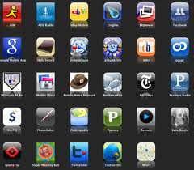
PAIRED Activity
Make a folder in your computing folder called mobileapps
Using MS Word – list as many APP’s as you can in five minutes!
Here are three to get you started:
Angry Birds
Amazon
Instagram
Talk to your partner – what is their favourite APP an why? (you may be asked to share this later on)

Slide 7

What did you come up with?
Class feedback… 3 mins

Slide 8

Looking back at those APP’s
Can you group any of those APP’s into a category?
i.e. Games, Communication, Commerce etc.
Take 5 more minutes to group APP’s together (do you have any interesting APP’s that you can’t place? Get ready to share!)

Slide 9

Researching APP’s
Use the worksheet provided on the Website to add your examples and research more examples of different APP’s.
Category of APP | Name of APP | What does the APP do? | Image of APP
Games | Angry Birds | You fire birds at different objects to destroy the green pigs
Education
Communication
Sheet needed – Category of APP

